Slide 1
IoT Self Study Component

Slide 2
Team Members:
Deepthi Bhat (1BM16CS003)
Aditi Awasthi (1BM16CS008)
Medhini Oak (1BM16CS047)

Slide 3
Topics Of Discussion
❑ Problem Statement
❑ Literature Survey
❑ Constraints
❑ Components And Modules
❑ Hardware and Software Requirements
❑ Cost Estimation
❑ Context Model
❑ Screenshots
❑ Conclusion

Slide 4
Problem Statement
CNC Writing Machine With Cloud Computation
Creation of a device to draw the basic form of a picture uploaded by the user to a hosted website, on paper using the concept of Internet of Things. This device will work using Arduino Uno microcontroller.

Slide 5
Literature Survey
Sl. No | Name of the Project or Product (Existing) | Commercial or Non-Commercial | Features
1 | Mill | Commercial | Translates programs consisting of specific numbers and letters to move the spindle (or work piece) to various locations and depths. Functions include: face milling, shoulder milling, tapping, drilling and some even offer turning.
2 | 3-D printer | Commercial | Allows the creation of a physical object from a three-dimensional digital model, typically by laying down many thin layers of a material in succession.
3 | Laser Cutter | Commercial | Uses a laser to cut materials, typically used for industrial manufacturing application. Laser cutting works by directing the output of a high-power laser most commonly through optics. The laser optics and CNC are used to direct the material or the laser beam generated.

Slide 6
Constraints
Speed of drawing will be slow
Monochromatic output
Due to jitter in the mechanical components, the picture drawn will be slightly wobbly in nature. Therefore, initially, the prototype will be tested using simpler input pictures containing mostly straight lines to check if the hardware is able to handle sensitive movements. Once it succeeds, we will advance to pictures containing curves.

Slide 7
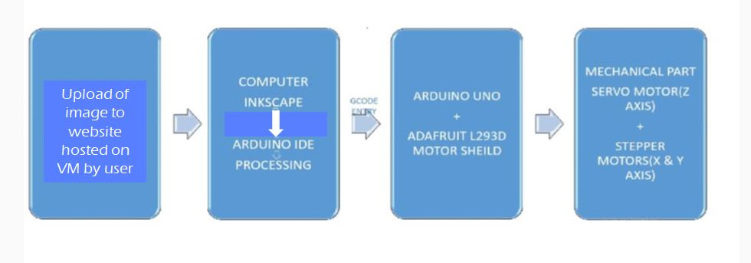
Components and Modules

Slide 8
Components and Modules
The 2D Pen Plotter works based on the principle of Computer Numerical Control. It works with two stepper motors and a servo motor, wherein it plots the input given from the computer on the drawing board using ATMEGA 328p microcontroller. The plotter has a two axis control using two stepper motors and a special mechanism to raise and lower the pen, using a servo motor.
Using the Microsoft Azure Portal, a Windows 2012 R2 Server Virtual Machine is installed on the cloud. The virtual machine is configured with Internet Information Services(IIS) and FastCGI to facilitate online access to the project website.
The software used for programming the Arduino board are namely Inkscape(0.48.5), Processing (3.0.2), Arduino IDE.

Slide 9
Electrical Hardware Components
2 PCs Nema 17 Stepper motor
Arduino Uno
L293D Motor Driver
L293D Speciﬁcations (Motor Driver IC)
The Device is a monolithic integrated high voltage, high current four channel driver designed to accept standard DTL or TTL logic levels and drive inductive loads (such as relays solenoides, DC and stepping motors) and switching power transistors. To simplify use as two bridges each pair of channels is equipped with an enable input. A separate supply input is provided for the logic, allowing operation at a lower voltage and internal clamp diodes are included. This device is suitable for use in switching applications at frequencies up to 5 kHz.
Mg 90 S Metal Gear Servo
9v DC Cell or battery

Slide 10
Mechanical Hardware Components
Part A: X-axis and Y-axis gantries
Wood for frame
Knitting Sticks
Sleeve(To hold the motor and the shaft together)
Shaft
Pen body
Screws + Tie Ups
Part B: FLEXIBLE NIB-PEN
Ball ben
Spring
Thread
Compass grip
Tools Required:
Drill machine
Cutting Machine
Glue gun

Slide 11
Software Requirements
Inkscape (Version 0.48.5)
Arduino IDE
Processing 3.0.2
Django 2.1 with IIS and FastCGI

Slide 12
Cost Estimation
2 PCs Nema 17 Stepper motor Rs. 953.26
Arduino Uno R3 Rs. 445.00
Mg 90 S Metal Gear Servo Rs. 319.00
L293D Motor Driver Rs. 180.00
Total cost for mechanical parts Rs. 350.00
Rent for Azure VM Free for a limited time
Miscellaneous Rs. 900.00
Total cost of the Project Rs. 2,247.26 + Rent for VM (after expiration of free period)
Total = ₹3000/- (approx)

Slide 13
Context Model
Gcode Generator (Inkscape+Makerbot plugin)
Cloud Computation
Processing IDE
Arduino Uno Board + Motor Shield
Pen Plotter Hardware with paper
Website hosted on Azure VM for user to upload image

Slide 14
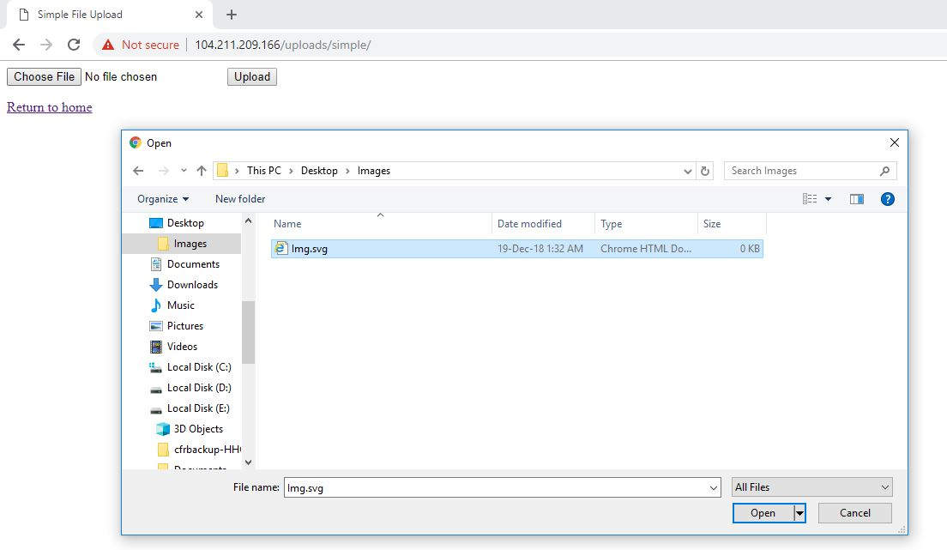
Screenshots

Slide 15
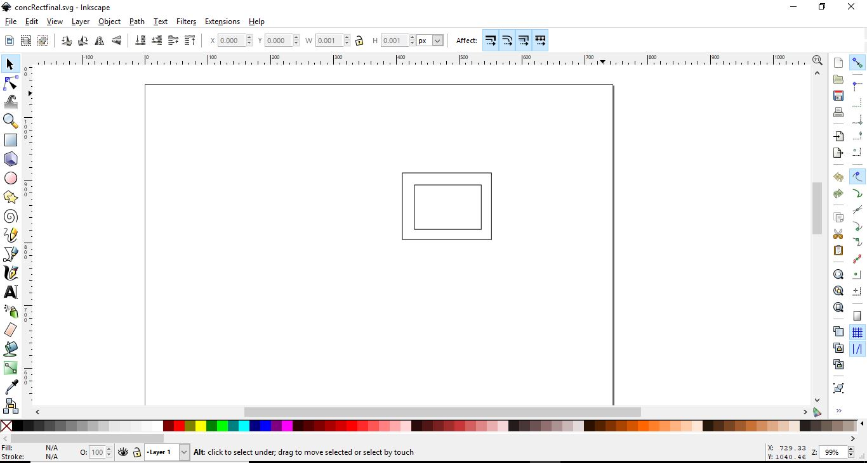
Screenshots

Slide 16
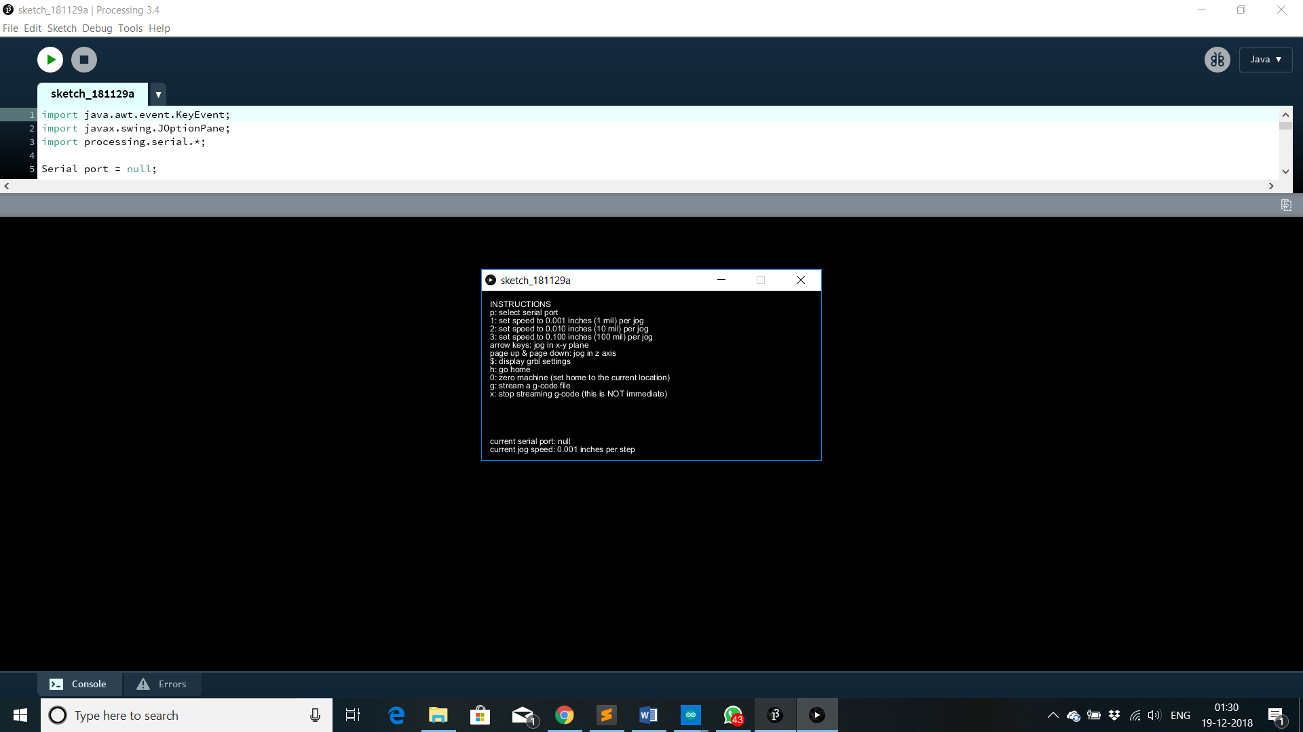
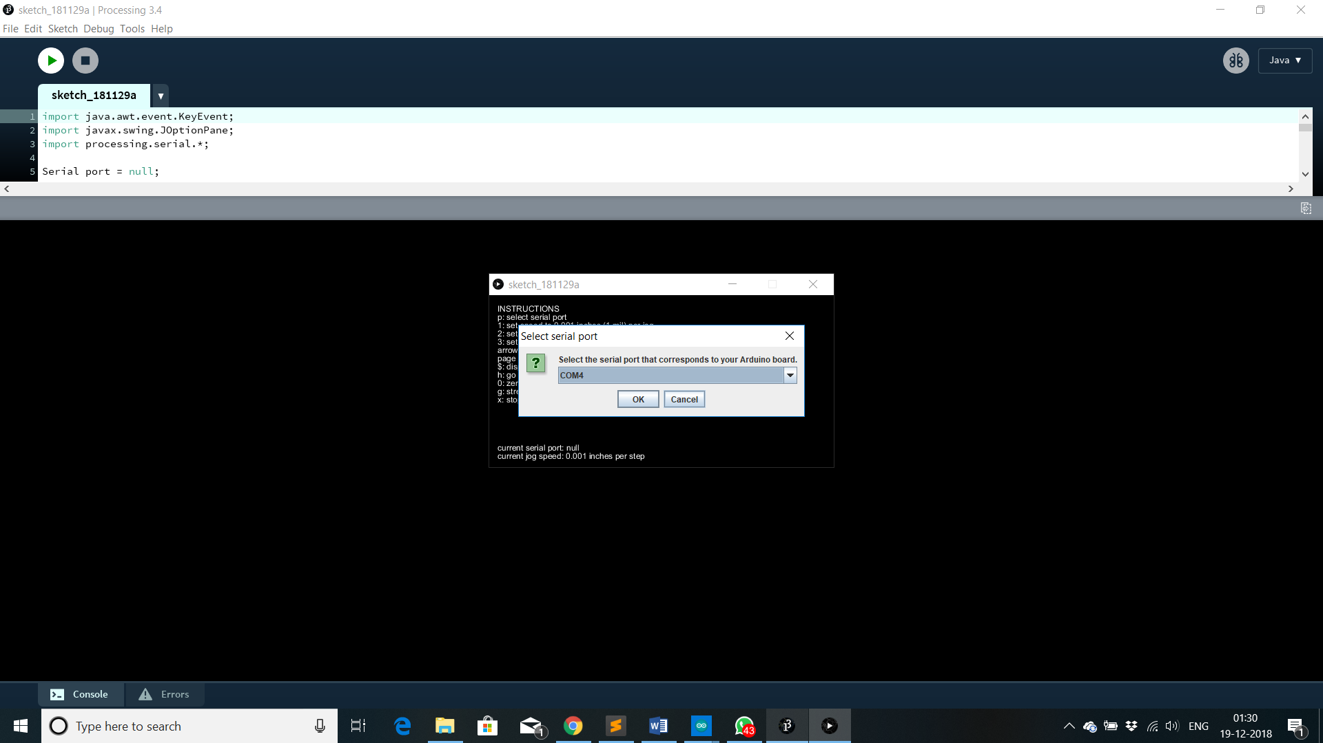
Screenshots

Slide 17
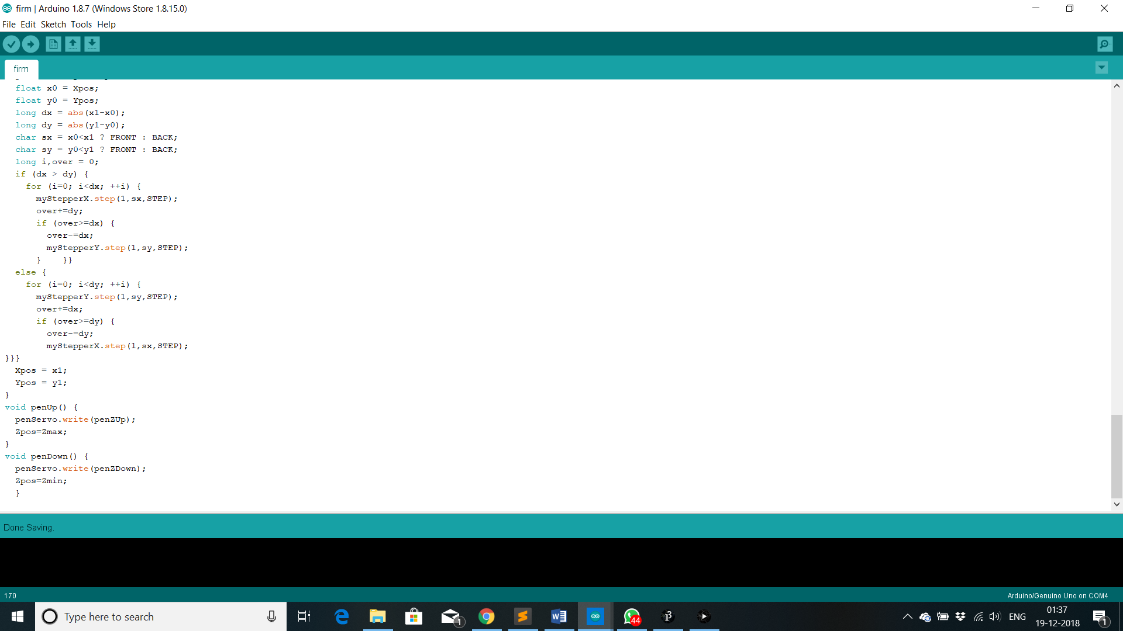
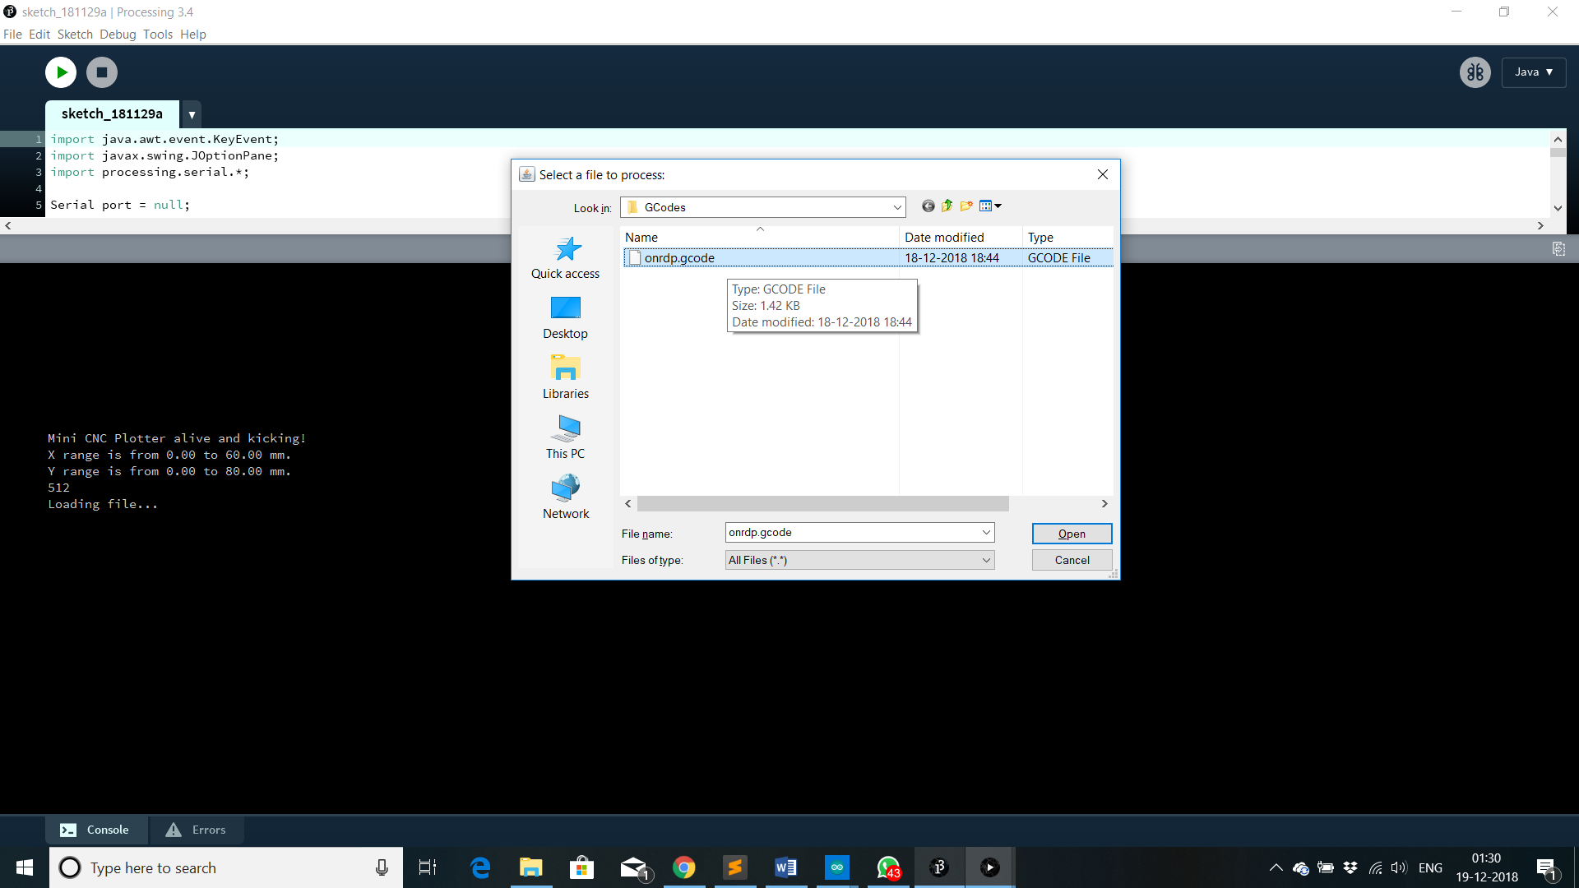
Screenshots

Slide 18
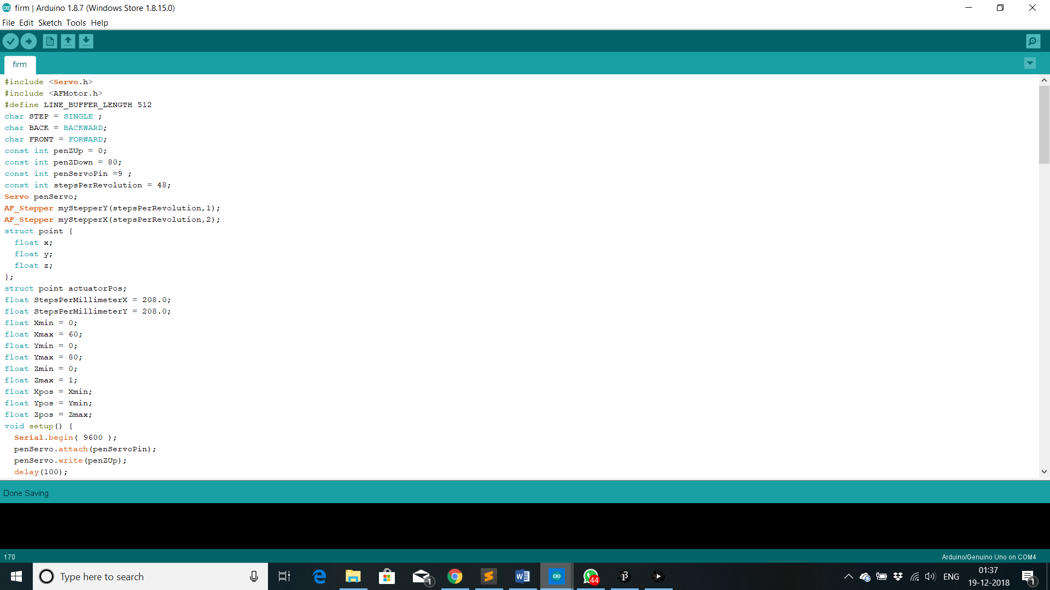
Screenshots

Slide 19
Conclusion
In modern CNC systems, end-to-end component design is highly automated using computer aided design (CAD) and computer-aided manufacturing (CAM) programs
PCB Mill (Future Enhancements) A PCB Mill is a device that etches out a pattern on a copper clad board such that it makes a Printed Circuit Board (PCB). PCBs are used everywhere in the ﬁeld of electrical engineering to connect electrical components to one another. Typically, after a board is designed, the layout ﬁles are sent to a manufacturer who then makes the board and ships it back to the customer. When prototyping, the delay and setup costs associated with sending a layout to a manufacturer can often mean days of down time. While this may not seem costly at ﬁrst, it can prove to be a signiﬁcant nuisance since most boards contain a wiring bug that was overlooked or misunderstood and must then be remade

Slide 20
Thanks!

